Slide 1
LESSON 1: Introduction

Slide 2
Table of contents
01
02
03
04
History of AI
Objectives
Course outline
Grading

Slide 3
History of AI
Contributors, companies, algorithms and perspectives

Slide 4
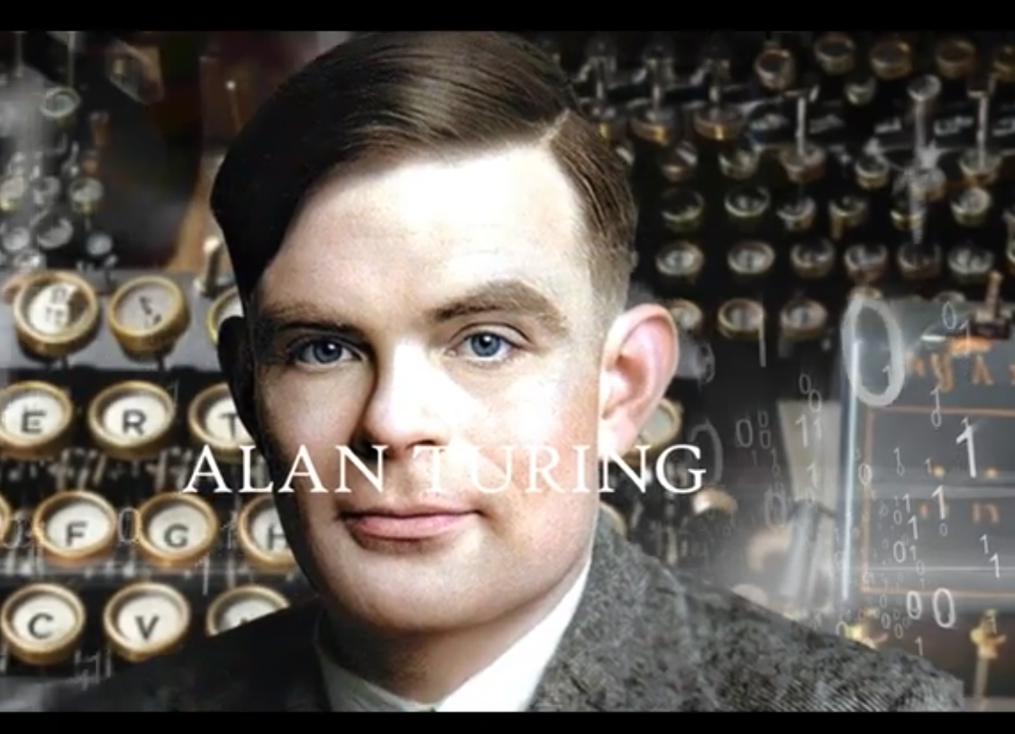
The first “computer”
In 1939, the Nazis were using the ENIGMA (an encryption machine) to coordinate their attacks.
The Allied forces turned to Alan Turing for help with decrypting the messages from this machine.
Traditional code breaking methods were ineffective thus Turing had to create a new machine.
This machine laid the foundation for modern day computers. Watch the movie “The Imitation Game”.

Slide 5
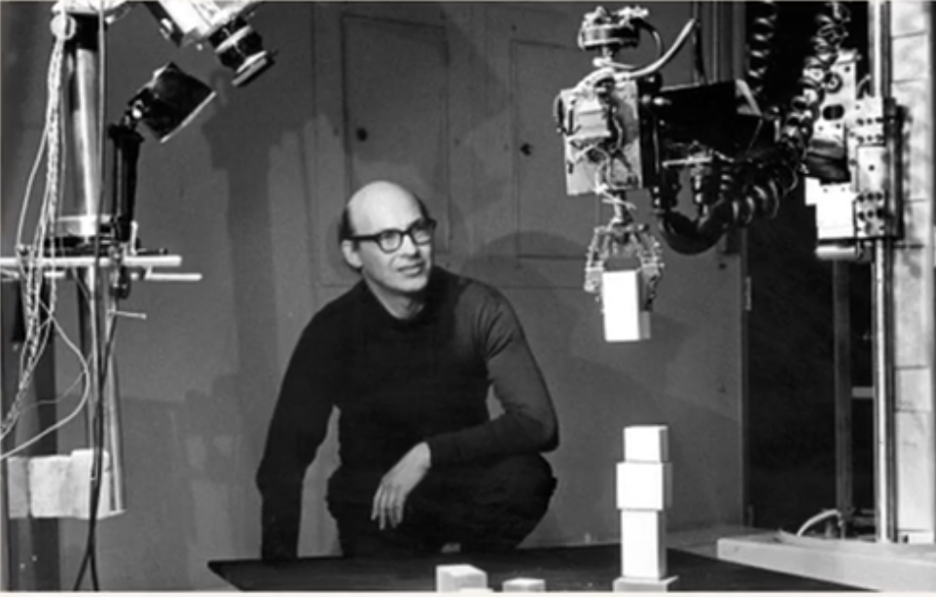
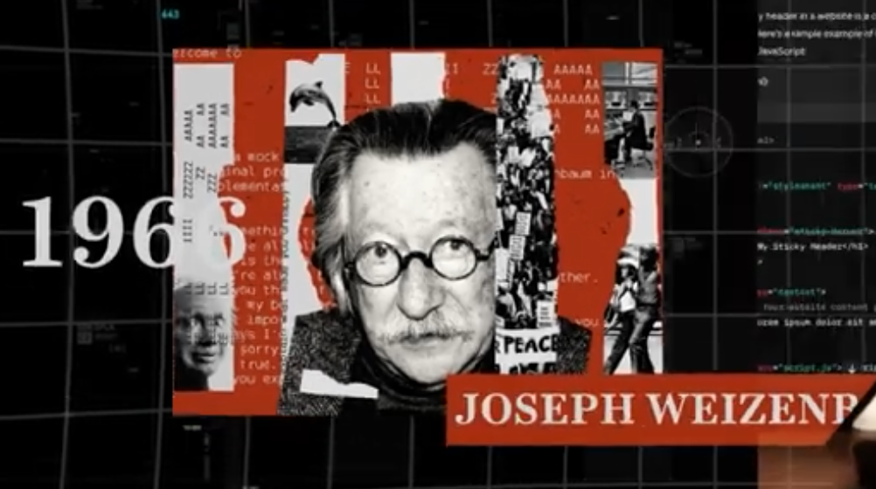

First chatbot and the microprocessor
In the 1950s, Marvin Minsky built the world’s first working neural network using wires and 6 vacuum tubes.
In 1966, a computer scientist at MIT called Joseph Weizenbaum builds ELIZA, the world’s first chatbot using IBM’s 794 computer.
In the 1970s, Intel created the microprocessor. This significantly shrunk the size of computers, making them accessible for domestic use (in homes).

Slide 6
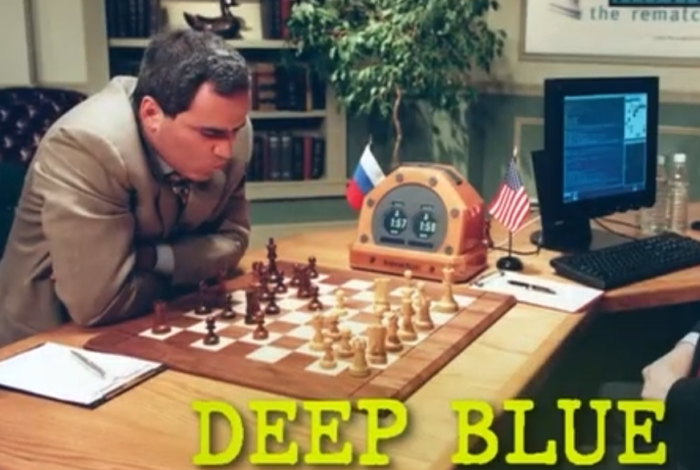
Backpropagation, AI blueprint
By the late 1970s, MicroSoft and Apple start creating computers for personal use, leading to the PC boom of the 80s and 90s.
In 1986, Geoffrey Hinton created the backpropagation algorithm. This algorithm is the backbone of all neural networks today.
In 1997, IBM built DeepBlue, a chess playing AI that beat the world champion at the time (Garry Kasparov).
This gave the blueprint for the future of AI: Data + Model (algorithms, formulae) + Compute (hardware)

Slide 7
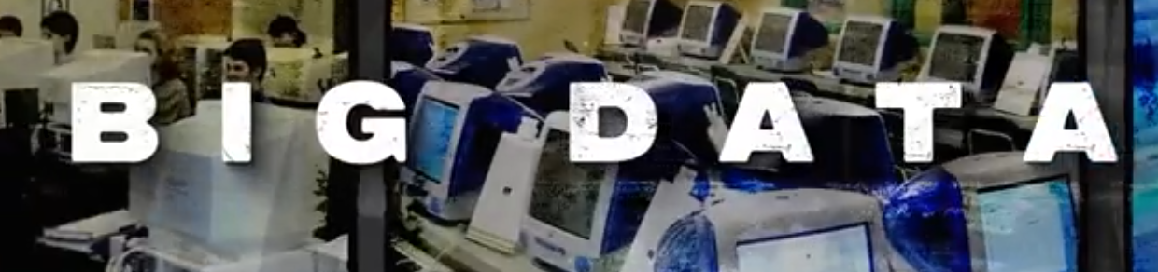
Information age, CNN
In the early 2000s, the creation of companies like Google, Facebook and Amazon brings about the information age, generating huge amounts of data.
This creates a need for computers to be able to analyze all this huge amounts of data.
In 2006, Geoffrey Hinton created a new algorithm called the Convolutional Neural Network (CNN) which allows computers to recognize patterns and images. This gives Geoffrey the name “The Godfather of AI”
This algorithm is used to tag and identify images or even to unlock phones

Slide 8
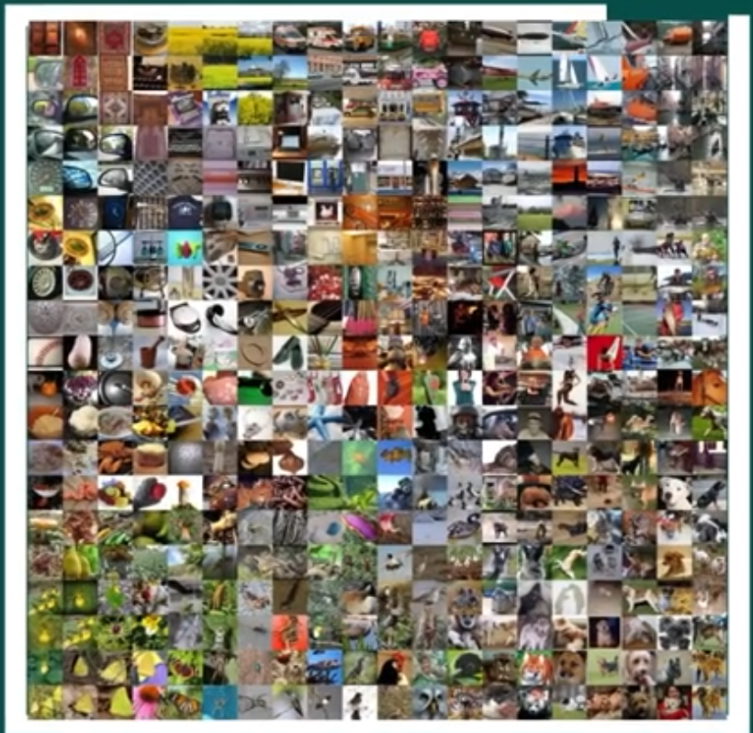
The Big Bang of AI
In 2007, the ImageNet competition was launched in order to find the best AI algorithm. In 2012, Geoffrey enters the competition with 2 of his students, their CNN model AlexNet wins and creates “The Big Bang of AI”
Google starts buying lots of different companies working in AI. By 2015, Google is dominating the AI model space
Elon Musk and some other billionaires didn’t want Google to be the only ones having access to super-intelligent AI, so they created OpenAI

Slide 9

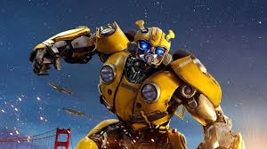
OpenAI creation, Transformers
OpenAI is meant to be an open-source, non-profit company geared towards building AGI (Artificial General Intelligence)
Elon steals one of Google’s top AI engineers.
In 2016, DeepMind builds AlphaGo and AlphaZero. AI programs that beat the best Go and chess players respectively.
In 2017, Google stumbled across transformers. Basically super smart robots that can read a lot of content very fast.

Slide 10
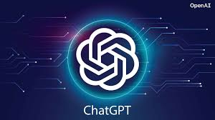


ChatGPT, other gen AIs
OpenAI has an idea to use transformers to create a modern chatbot but they don’t have the funds to do it.
So they partner up with Microsoft in 2020 procuring $10 billion investment from Microsoft.
With this new capital, OpenAI launches ChatGPT (Chatting Generative Pretrained Transformer) in 2022
Other companies also launch their own generative Ais this year too: 11Labs, Midjourney and stability.ai

Slide 11
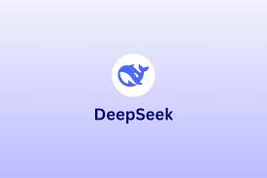
The Present
There are more generative AI models than one can count out there now, each with their own specialties
DeepSeek came out, rivaling ChatGPT’s performance while only using a fraction of its capital.
Researchers say that Gen AI can’t get much better than it is now due to limits in amount of data.

Slide 12
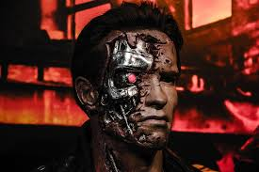
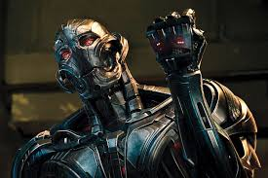
Where do we go from here
The AI that we are all afraid will take over the Earth and exterminate all humans is still to come.
This is sometimes termed as AGI (Artificial General Intelligence) or ASI (Artificial Super Intelligence). These AI systems will be able to learn new things without being explicitly trained to do so.
They will also be able to transfer knowledge acquired from one domain to another.
The estimated time of arrival of these systems is anywhere from a few decades to at least a century. Whatever the case, I hope I’ll be dead by then.

Slide 13
Artificial Intelligence
Definition, classification of AI,

Slide 14
Definition
AI (Artificial Intelligence) refers to the simulation of human intelligence in machines.
This allows them to perform tasks that require reasoning, learning and decision-making.
AI systems can process data, recognize patterns, adopt over time based on their interactions.
For this course, AI will be considered as using computers to solve complex problems without explicitly telling them how.
We will look at some algorithms/techniques that may not be considered “modern AI” but these algorithms have widespread uses.

Slide 15
Classification of AI
AI can be classified based on capabilities, functionalities (purpose) and learning approach.
Classification based on capabilities
Narrow AI (weak AI): specialized AI designed for specific tasks (e.g. ChatGPT, Google Assistant, Siri). This is where we currently at, even the most advanced AI systems are still narrow AI.

Slide 16
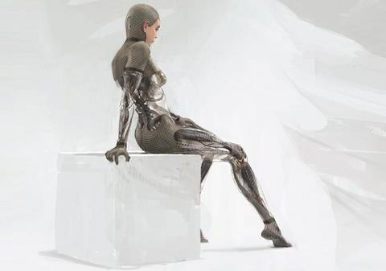
Classification of AI
Classification based on capabilities
AGI (Artificial General Intelligence): hypothetical AI with human-like cognitive abilities, capable of reasoning and learning across various domains.
Super AI (ASI – Artificial Super Intelligence): theoretical AI that surpasses human intelligence in all aspects

Slide 17
Classification of AI
Classification based on functionality (or purpose)
Generative AI: AI models that are trained on lots of content and are able to create new content (e.g. images, text, videos, etc.).
LLMs (Large Language Models): a specific type of Gen AI that are trained to understand human language.
Predictive AI: forecasts outcomes based on data
Autonomous AI: acts independently in decision-making (e.g. self-driving car or robotics)
Conversational AI: AI focused on dialogue interactions

Slide 18
Classification of AI
Classification based on learning approach. Refers to the type of data used to create the data
Supervised learning: trained on labeled data
Unsupervised learning: finds pattern in unlabeled data (e.g. clustering, anomaly detection)
Reinforcement learning: learns by interacting with an environment and receiving rewards or punishments (e.g. AlphaGo, robotics)
Self-supervised learning AI: learns from raw data without explicit labels (e.g. modern LLMs)

Slide 19
When to create AI systems
This course is meant to prepare you for the integration of AI systems into your applications.
But not all systems need AI. Here we are going to list some cases where AI is necessary and when it isn’t
When to create AI
When a system requires pattern recognition (e.g. fraud detection, facial recognition, medical diagnostics)
When handling large-scale data processing (e.g. search engines, recommendation systems)
When personalizing user experiences dynamically (e.g. recommendation systems)

Slide 20
When to create AI systems
When not to create AI
When a simple rule-based system suffices (e.g., basic form validation, arithmetic calculations).
When data is insufficient or biased, leading to unreliable AI decisions.
When explainability and transparency are crucial (e.g., legal and ethical decisions where black-box AI could be problematic).
When real-time processing with guaranteed accuracy is needed, but AI predictions are probabilistic (e.g., critical medical or aviation control systems).

Slide 21
Conclusion
AI should be used wisely.
While AI can greatly enhance automation and decision-making, it is not always the best choice, especially when simpler, rule-based approaches can achieve the same results efficiently and reliably.

